Slide 1
Software Maintenance

Slide 2
Questions
What is maintenance?
When is it required?
Why it is required?

Slide 3
Answers
Activities required or undertaken to conserve as nearly, and as long, as possible the original condition of an asset or resource while compensating for normal wear and tear
The life of your software does not end when it finally launches. In reality, its life has just begun
To avoid any major breakdown

Slide 4
Introduction
Software maintenance in software engineering is the modification of a software product after delivery
  to correct faults,
  to improve performance or other attributes.
A common perception of maintenance is that it merely involves fixing defects
Software maintenance is widely accepted part of SDLC now a days.
It stands for all the modifications and updates done after the delivery of software

Slide 5
Types of Maintenance
Corrective Maintenance - This includes modifications and updates done in order to correct or fix bugs, which are either discovered by user or concluded by user error reports.
Adaptive Maintenance - This includes modifications and updates applied to keep the software product up-to date and tuned to the ever changing world of technology and business environment

Slide 6
Perfective Maintenance - This includes modifications and updates done in order to keep the software usable over long period of time.
  It includes new features,
  new user requirements for refining the software and improve its reliability and performance
Preventive Maintenance - This includes modifications and updates to prevent future problems of the software. It aims to attend problems, which are not significant at this moment but may cause serious issues in future

Slide 7
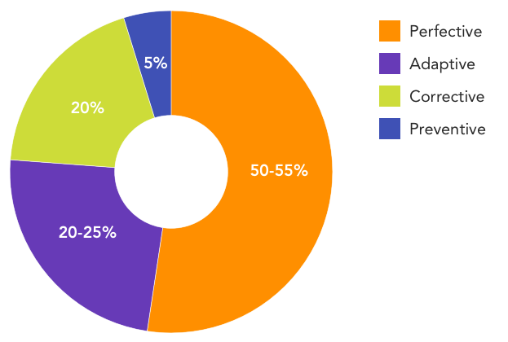

Slide 8
Maintainability
Maintainable software exhibits:
Effective modularity.
It makes use of design patterns that allow ease of understanding.
It has been constructed using well-defined coding standards and conventions.
It has undergone a variety of quality assurance techniques.
It has been created by software engineers who recognize that they may not be around when changes must be made.
Therefore, the design and implementation of the software must “assist” the person who is making the change.

Slide 9
SOFTWARE SUPPORTABILITY
Definition: The capability of supporting a software system over its whole product life.
This implies satisfying any necessary needs or requirements, but also the provision of equipment, support infrastructure, additional software, facilities, manpower, or any other resource required to maintain the software operational and capable of satisfying its function.

Slide 10
It should be addressed as part of the requirements model (or specification) and considered as the design evolves and construction commences.
The software should contain facilities to assist support personnel when a defect is encountered
Support personnel should have access to a database that contains records of all defects that have already been encountered—their characteristics, cause, and cure.
This will enable support personnel to examine “similar” defects and may provide a means for more rapid diagnosis and correction.
Although defects encountered in an application are a critical support issue, supportability also demands that resources be provided to support day-to-day end-user issues.
The job of end-user support personnel is to answer user queries about the installation, operation, and use of the application.

Slide 11
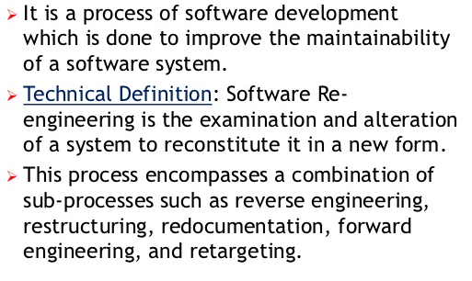
REENGINEERING

Slide 12
BUSINESS PROCESS REENGINEERING
Business process reengineering (BPR) extends far beyond the scope of information technologies and software engineering.
Definition: “the search for, and the implementation of, radical change in business process to achieve breakthrough results.”
Business Processes: A business process is “a set of logically related tasks performed to achieve a defined business outcome”.
Every business process has a defined customer—a person or group that receives the outcome (e.g., an idea, a report, a design, a service, a product).

Slide 13
In addition, business processes cross organizational boundaries. They require that different organizational groups participate in the “logically related tasks” that define the process.
Every system is actually a hierarchy of subsystems. A business is no exception.
The overall business is segmented in the following manner:
The business -> business systems -> business processes -> business subprocesses.
Each business system (also called business function) is composed of one or more business processes, and each business process is defined by a set of subprocesses.
BPR can be applied at any level of the hierarchy, but as the scope of BPR broadens the risks associated with BPR grow dramatically.

Slide 14
A BPR Model
Like most engineering activities, business process reengineering is iterative.
Business goals and the processes that achieve them must be adapted to a changing business environment.
For this reason, there is no start and end to BPR—it is an evolutionary process.
The model defines following six activities:
Business definition. Business goals are identified within the context of four key drivers:
  cost reduction,
  time reduction,
  quality improvement
  personnel development and empowerment.
Goals may be defined at the business level or for a specific component of the business.

Slide 15
Process identification. Processes that are critical to achieving the goals defined in the business definition are identified.
They may then be ranked by
  importance
  by need for change
  or in any other way that is appropriate for the reengineering activity.
Process evaluation. The existing process is thoroughly analyzed and measured. Process tasks are identified; the costs and time consumed by process tasks are noted; and quality/performance problems are isolated.

Slide 16
Process specification and design. Based on information obtained during the first three BPR activities, use cases are prepared for each process that is to be redesigned. Within the context of BPR, use cases identify a scenario that delivers some outcome to a customer. With the use case as the specification of the process, a new set of tasks are designed for the process.
Prototyping. A redesigned business process must be prototyped before it is fully integrated into the business. This activity “tests” the process so that refinements can be made.
Refinement and instantiation. Based on feedback from the prototype, the business process is refined and then instantiated within a business system.

Slide 17
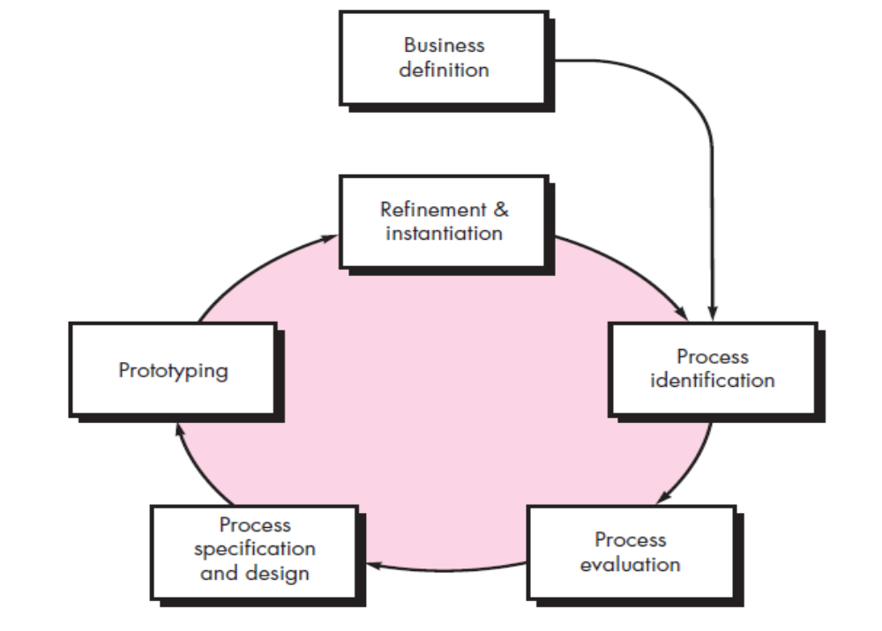

Slide 18
SOFTWARE REENGINEERING
The scenario is all too common:
An application has served the business needs of a company for 10 or 15 years. During that time it has been corrected, adapted, and enhanced many times. People approached this work with the best intentions, but good software engineering practices were always shunted to the side (due to the press of other matters). Now the application is unstable. It still works, but every time a change is attempted, unexpected and serious side effects occur. Yet the application must continue to evolve. What to do?
Unmaintainable software is not a new problem. In fact, the broadening emphasis on software reengineering has been spawned by software maintenance problems that have been building for more than four decades.

Slide 19
A Software Reengineering Process Model
Reengineering takes time, it costs significant amounts of money, and it absorbs resources that might be otherwise occupied on immediate concerns.
Reengineering of information systems is an activity that may absorb information technology resources for many years. That’s why every organization needs a pragmatic strategy for software reengineering.

Slide 20
Principles:
Before you can start rebuilding, it would seem reasonable to inspect the existing software.
Before you tear down and rebuild the entire new software, be sure that the structure of existing is weak.
Before you start rebuilding be sure you understand how the original was built.
If you begin to rebuild, use only the most modern, long-lasting techniques.
If you decide to rebuild, be disciplined about it. Use practices that will result in high quality—today and in the future

Slide 21
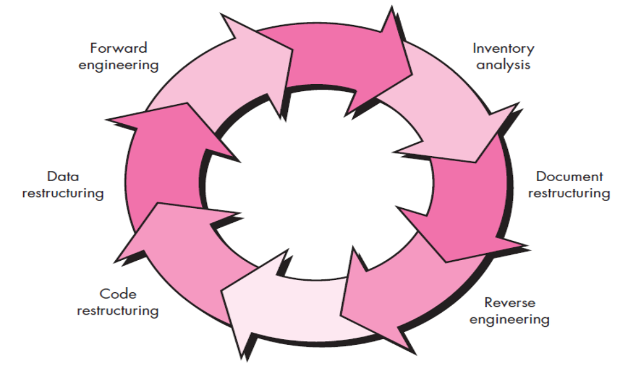
To implement these principles, you can use a software reengineering process model that defines six activities, shown in following Figure.
In some cases, these activities occur in a linear sequence, but this is not always the case.

Slide 22
Software Reengineering Activities
The reengineering paradigm shown in following figure is a cyclical model.
This means that each of the activities presented as a part of the paradigm may be revisited.
For any particular cycle, the process can terminate after any one of these activities.
1. Inventory analysis: Every software organization should have an inventory of all applications.
The inventory can be nothing more than a spreadsheet model containing information that provides a detailed description (e.g., size, age, business criticality) of every active application.
By sorting this information according to business criticality, longevity, current maintainability and supportability, and other locally important criteria, candidates for reengineering appear.
Resources can then be allocated to candidate applications for reengineering work.
Inventory should be revisited on a regular cycle.
The status of applications (e.g., business criticality) can change as a function of time, and as a result, priorities for reengineering will shift.

Slide 23
2. Document restructuring. Weak documentation is the trademark of many legacy systems. But what can you do about it? What are your options?
a) If the system works, you may choose to live with what you have. In some cases, this is the correct approach. It is not possible to re-create documentation for hundreds of computer programs. If a program is relatively static, is coming to the end of its useful life, and is unlikely to undergo significant change, let it be!
b). Documentation must be updated, but your organization has limited resources. You’ll use a “document when touched” approach. It may not be necessary to fully redocument an application. Rather, those portions of the system that are currently undergoing change are fully documented. Over time, a collection of useful and relevant documentation will evolve.
c) The system is business critical and must be fully redocumented. Even in this case, an intelligent approach is to pare documentation to an essential minimum.
Each of these options is viable. Your software organization must choose the one that is most appropriate for each case.

Slide 24
3. Reverse engineering. The term reverse engineering has its origins in the hardware world.
Successful reverse engineering derives one or more design and manufacturing specifications for a product by examining actual specimens of the product
Reverse engineering for software is the process of analyzing a program in an effort to create a representation of the program at a higher level of abstraction than source code.
Reverse engineering is a process of design recovery.
Reverse engineering tools extract data, architectural, and procedural design information from an existing program.
4. Code restructuring. Some legacy systems have a relatively solid program architecture, but individual modules were coded in a way that makes them difficult to understand, test, and maintain.
In such cases, the code within the suspect modules can be restructured.
To accomplish this activity, the source code is analyzed using a restructuring tool.
Violations of structured programming constructs are noted and code is then restructured (this can be done automatically) or even rewritten in a more modern programming language.
The resultant restructured code is reviewed and tested to ensure that no anomalies have been introduced. Internal code documentation is updated.

Slide 25
5. Data restructuring: A program with weak data architecture will be difficult to adapt and enhance.
Unlike code restructuring, which occurs at a relatively low level of abstraction, data restructuring is a full-scale reengineering activity.
In most cases, data restructuring begins with a reverse engineering activity.
Current data architecture is dissected, and necessary data models are defined.
Data objects and attributes are identified, and existing data structures are reviewed for quality.
When data structure is weak (e.g., flat files are currently implemented, when a relational approach would greatly simplify processing), the data are reengineered.
Because data architecture has a strong influence on program architecture and the algorithms that populate it, changes to the data will invariably result in either architectural or code-level changes.

Slide 26
6. Forward engineering: In an ideal world, applications would be rebuilt using an automated “reengineering engine.”
The old program would be fed into the engine, analyzed, restructured, and then regenerated in a form that exhibited the best aspects of software quality.
In the short term, it is unlikely that such an “engine” will appear, but vendors have introduced tools that provide a limited subset of these capabilities that addresses specific application domains (e.g., applications that are implemented using a specific database system).
More important, these reengineering tools are becoming increasingly more sophisticated.
Forward engineering not only recovers design information from existing software but uses this information to alter or reconstitute the existing system in an effort to improve its overall quality. In most cases, reengineered software re-implements the function of the existing system and also adds new functions and/or improves overall performance.

Slide 27
SOFTWARE REENGINEERING
Change Requirements
Requirements Specification
New Requirements Specification
Design
Design
Code
Code

Slide 28
SOFTWARE REENGINEERING
Advantages of reengineering:
  Produces better design than the original product.
  Produces required documents.
  Often results in higher efficiency.

Slide 29
THE ECONOMICS OF REENGINEERING
In a perfect world, every unmaintainable program would be retired immediately, to be replaced by high-quality, reengineered applications developed using modern software engineering practices.
But we live in a world of limited resources. Reengineering drains resources that can be used for other business purposes. Therefore, before an organization attempts to reengineer an existing application, it should perform a cost-benefit analysis.
A cost-benefit analysis model for reengineering has been proposed.
Nine parameters are defined.
The cost-benefit analysis presented in these equations can be performed for all high priority applications identified during inventory analysis.
Those applications that show the highest cost-benefit can be targeted for reengineering, while work on others can be postponed until resources are available.

Slide 30
